Slide 1
Introduction to Information Management
IT.412: Information Management

Slide 2
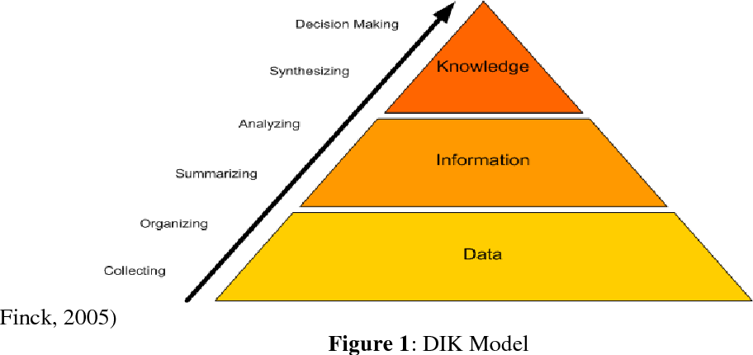
What is Information?

Slide 3
Data vs Information
Data
Comprises of facts, observations, or perceptions
Represents raw numbers, or assertions
Raw facts
Information
Processed Data
Data with context
Value added to data
Summarized
Organized
Analyzed

Slide 4
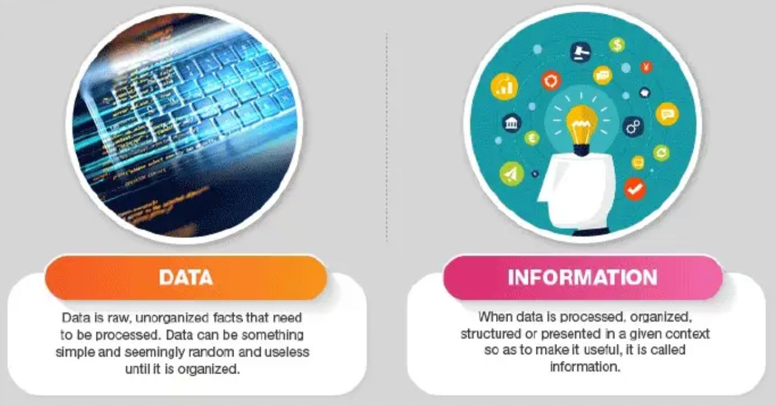
Data vs Information

Slide 5

What is Knowledge
A justified true belief
Highest level of the hierarchy, on top of data and information
It is the deepest, richest, & most valuable of the three
Information with direction

Slide 6
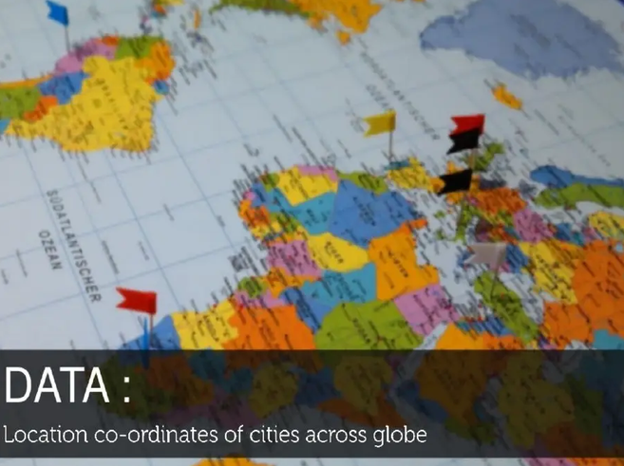

Slide 7


Slide 8
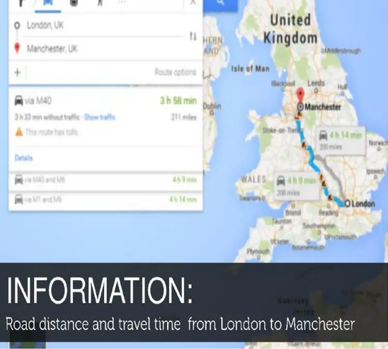

Slide 9
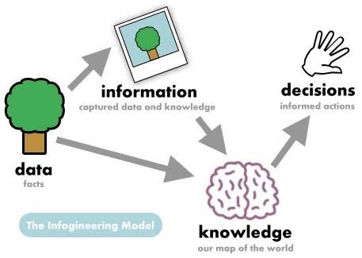
Data, Information, and Knowledge
Notes:
In businesses, what’s most important is the decisions that spring from raw data. Knowing how to transform raw data into information, and then into knowledge that is helpful for a business would be greatly beneficial in expediting business growth.

Slide 10
What is Information Management?

Slide 11
Information Management
Laypeople – Views it as a general flow of daily info
Working people – Focuses on acquiring, processing, and using information for work
IT Specialist – Concerned with data storage, database management, and system delivery
The set of activities and discipline required to manage information as a critical business resource, bridging the gap between Information Technology (IT) and strategic business benefits.

Slide 12
Information Management
For everyone, the flow of information through their lives has become critical to their twenty-first century existence.
The term “information management” is increasingly common in non-technical fields like government and engineering.
Notes:
For everyone (from the most uneducated lay person to the most expert information systems specialist, whether they realise it or not)

Slide 13
Evolution of Information Management
The Early Days (1960s): Focus on automating labor-intensive office tasks like accounting and invoicing.
The Maturing Years (1980s–90s): Commercial organizations seeking strategic advantage and managing the rapidly shrinking "window" of that advantage.
Modern Day: Technology is now truly ubiquitous, and national boundaries are dissolving as individual power increases.

Slide 14
Evolution of Information Management
The vast majority of the issues in the early years were those associated with how to supply information systems to business.
Information technology was a driver of cost rather than a source of new thinking and innovation.
The principal problem was finding people who could do the work rather than making sure that the work was what was needed.

Slide 15
Evolution of Information Management
This shift of attention in the modern day has highlighted issues relating to managing the demand for information systems in organizations.
Organizations are now searching for new business opportunities that might change the nature of the business and what kind of business it is.
As a result, it highlighted the growing disconnect between IT and business professionals. Slowly, the status of the IT department in organizations diminished.

Slide 16
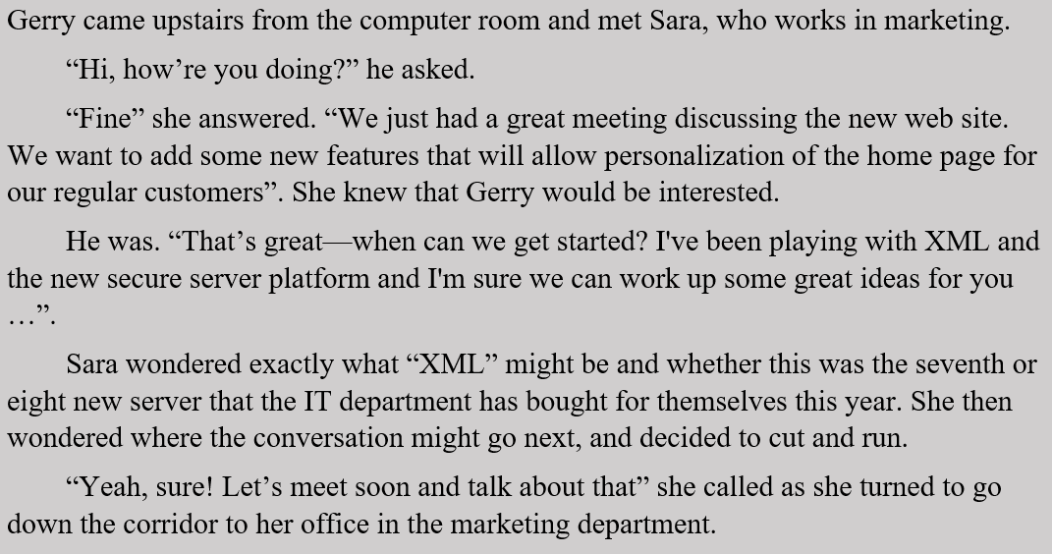
A Case Study
Notes:
Who are the characters in this passage? What departments do they work for?
For each character, which part of the conversation do they clearly care about? How about the parts they don’t understand?
What is the core problem of this conversation? What were the goals, language, and priorities of all parties involved? Do they connect?
Sara walked away before any requirements were agreed upon. Imagine that Gerry starts building the new personalized homepage tomorrow using only what he heard in this conversation. List three specific things that could go wrong with the final product from Sara's perspective.
As a consultant hired by this company, recommend one practical change on how the different teams in this passage interact.

Slide 17
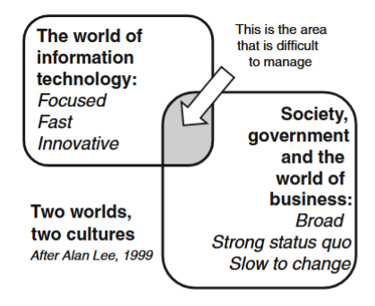
There shouldn’t be a “chasm”
Notes:
These two worlds intersect in a way that makes clear the joint area that is so difficult (but so important) to manage.
Rather than a wall, or chasm, he suggests that there is an area of common concern that we must understand and work with so as to make sure that information technology makes a good and proper contribution to society at large and business in particular.
Hence, it is the overlap between the world of IT and the world of “the business” that needs to be managed, not a chasm.

Slide 18
The New Goal of IT Professionals
IT professionals are now expected to get closer to the business and to help build information management skills within the business that will bring a focus on the business benefits rather than the technical problems.
IT management needs to promote a better understanding of the benefits of information technology and systems investments:
how they can be defined
how they can be managed
how they can be measured
how they can be demonstrated in a way that senior business management understands.
Notes:
New Role: Transitioning from "systems analysts" (requirements) to business analysts (wholesale change)

Slide 19
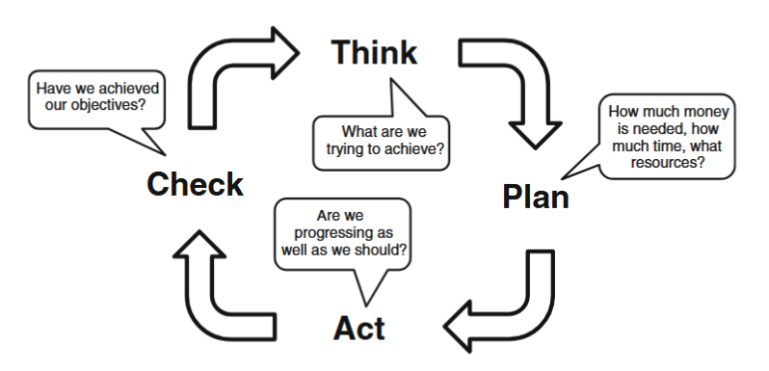
Management 101
A common view of management, often taught in early classes dealing with management theory, is that it comprises four principal activities: Think, Plan, Act and Check.
Notes:
This four-stage sequence reminds us that—conventionally—we have to
think about what we hope to be able to do, make plans that ensure that we have all
the financial, human and material resources needed, execute the plan by means of
appropriate actions and finally check that all went as intended and that the desired
results were obtained.

Slide 20
Management 101: Competencies for Success
The scope of modern ambition requires Business Analysts focused on wholesale business change, not just requirements gathering.
While technology provides the opportunity, people and the management of change remain the primary issues.
No single role (like a project manager) can deliver success alone; all stakeholders must collaborate in the middle ground of business change.

Slide 21
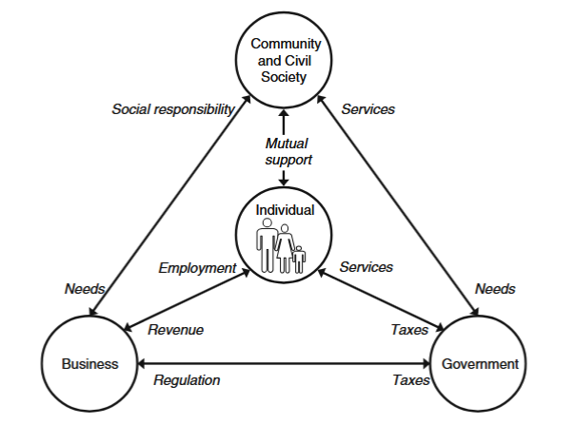
Stakeholder context
Notes:
Individuals are employees within businesses, and yet they are customers; individuals are tax payers and yet they may work as public servants; virtually all individuals would admit to living within communities, another context within which different needs and priorities emerge.
With this high-level view in mind, we can begin to understand that one technology—let us think of the smart phone, or the “tablet”?—can impact on one or all
of these stakeholder groups at the same time, but differently. The impact might be advantageous to one group but not to the others. This view of our world is a useful reminder that there are patterns of dependency within which we live, work and pay our taxes.

Slide 22
Thank you for listening!
https://www.scribd.com/presentation/581918008/Unit-1-Introduction-to-Data-Information-Knowledge
https://www.cambridgeinternational.org/images/285017-data-information-and-knowledge.pdf
Bytheway, A. (2014). Investing in information: The Information Management Body of Knowledge. Springer.

